Slide 1
Styling In XML

Slide 2
Objectives
Review Selectors and Display Attributes
Review Pseudo Elements
Create an XSLT style sheet
Transform an XML document
Create templates to format sections of the XML document
Sort the contents of an XML document
Create conditional nodes to generate different HTML code
Use predicates to select subsets of an XML document
Insert new elements and attributes in the transformed document
Notes:
You’ve seen in your labs that browsers can not only render HTML but also XML as well
Briefly talk about CSS based styling

Slide 3
Using Selectors
For XML selectors are the element names in the XML file
HTML – p {font-weight: bold;}
XML – patient {font-weight: bold;}
Play {
display: block;
width: 680px;
font-family: Times New Roman;
font-size:12pt;
border: 1px solid black;
margin: 5px;
padding: 15px;
}
Summary {
display: block;
text-align: justify
}
Notes:
This is old news to you because in Lab 3, you styled Hamlet (next slide)

Slide 4
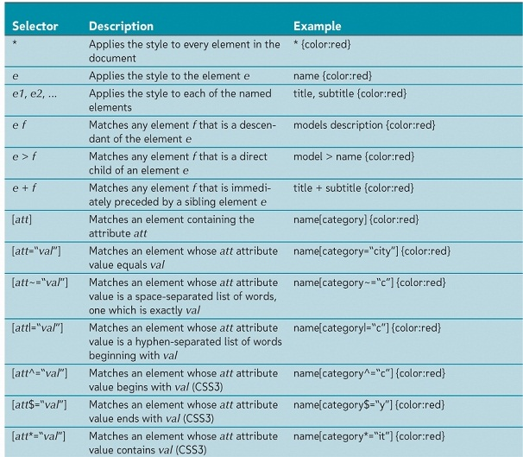
Notes:
Just Review won’t read every one of these selectors
But be aware that you have the ability to select specific elements and attribute combinations

Slide 5
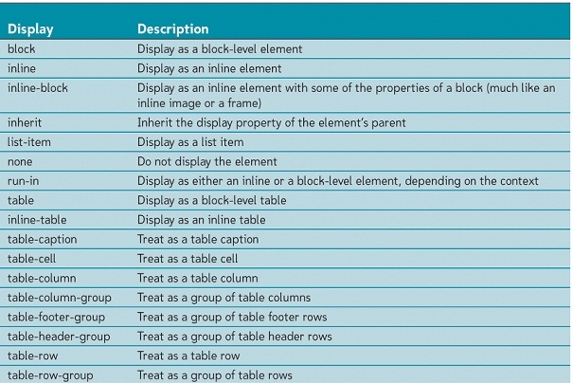

Slide 6
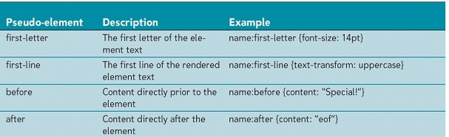
Pseudo Elements and Pseudo Classes
General class of selectors
Specify elements based on a conjunction that does not involve the element’s name
CSS also allows pseudo-class selectors for items in the document that are not elements

Slide 7
Other Selectors
:root
Attributes to the root of the file. Can be used on any file
:first-child & :last-child
:not – can be used on almost any selector
img:not([border]) {border: 1;}
Notes:
Suffice to say that there are a lot and you need to think a little bit differently about how they would be used.

Slide 8
XSLT Introduction
XSLT is a language for transforming XML documents
An XSLT style sheet contains instructions for transforming the contents of an XML document into another format (usually HTML)
An XSLT style sheet document is itself an XML document
An XSLT style sheet document has an extension .xsl
Notes:
XML Input + XSLT code -> XSLT processor -> Result document

Slide 9
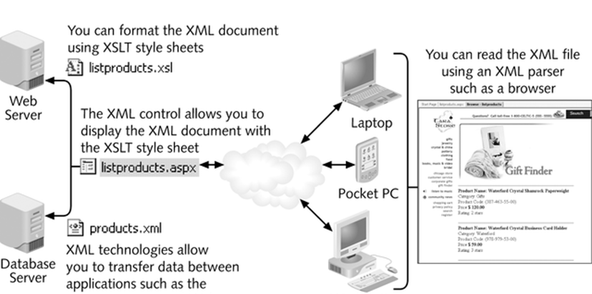
Generating a Result Document
Notes:
Predates JS Bootstrap and other mobile friendly technologies that adapt to mobile constrains

Slide 10
Where Is It Done?
The transformation can be performed by a server or a client
In a server-side transformation, the server receives a request from a client, applies the style sheet to the source document, and returns the result document to the client
In a client-side transformation, a client requests retrieval of both the source document and the style sheet from the server, then performs the transformation, and generates the result document
Notes:
Supported browsers: Safari, Chrome, Firefox, Opera and IR support XSLT 1.0, (not 2.0 without extensions)
For security reasons Chrome does not support externally references XSLT files

Slide 11
Stages in Transforming
First Phase - Structural transformation
Data is converted from the structure of the incoming XML to the structure of the desired output
Second Phase - Formatting transformation
New structure is changed to the required format like HTML, PDF, SQL Server, Oracle, etc.

Slide 12
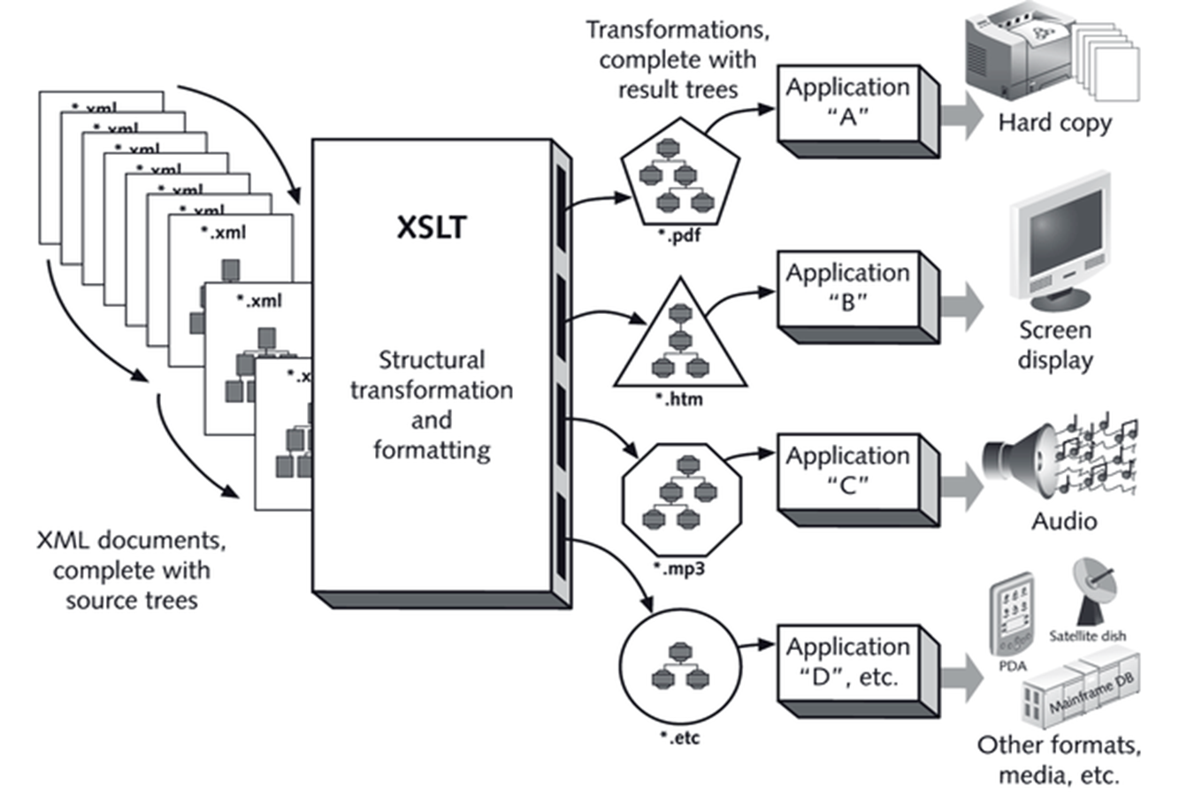
Two Step Transformation

Slide 13
XML Stylesheet Language (XSL)
XSL: XML vocabulary for specifying formatting objectives (sometimes called XSL-FO for XSL Formatting)
XSL Transformation (XSLT): the language for transforming XML documents
XML Path Language (XPath): an expression language used to ask or refer to part of an XML document
Notes:
Stop and show sample (example 2 from wiki)
Show Sales Example in lecture examples folder

Slide 14
Creating a Style Sheet
To create an XSLT style sheet, the general structure is:
<xsl:stylesheet version="1.0" xmlns:xsl=http://www.w3.org/1999/XSL/Transform>
<!- - Put your formatting code here - - >
</xsl:stylesheet>
xmlns:xsl attribute indicates the schema to be supported for the style sheet
Notes:
Create the root of the xsl stylesheet by copy and paste

Slide 15
Attaching a Style Sheet in XML
Processing instruction should be inserted directly below the first line in the XML file
Specify the name and location of files containing the style sheet
<?xml-stylesheet type="text/css" href="url" ?>
<?xml-stylesheet type="text/xsl" href="stylesheet.xsl"?>

Slide 16
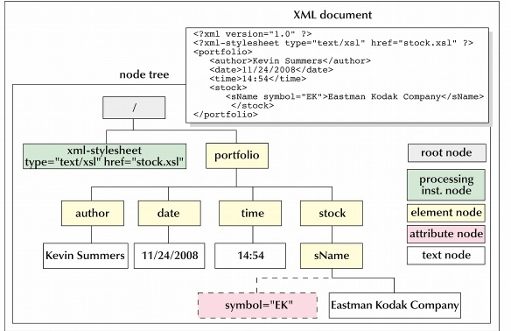
XML Node Tree

Slide 17
Working with Document Nodes
Nodes are distinguished based on the object they refer to in the document
XPath provides the syntax to refer to the various nodes in the node tree
Syntax is same as operating systems (../name, etc)
Location of a node can be expressed in either absolute or relative terms
XPath also does data extraction

Slide 18
Using XPath to Reference a Node
For absolute path, XPath begins with the root node, identified by a forward slash and proceeds down the levels of the node tree
An absolute path: /child1/child2/child3/…
To reference an element without regard to its location in the node tree, use a double forward slash with the name of the descendant node
A relative path : //descendant

Slide 19
Referencing Groups of Elements
XPath allows you to refer to groups of nodes by using the wildcard character (*)
To select all of the nodes in the node tree, you can use the path:
//*
The (*) symbol matches any node, and the (//) symbol matches any level of the node tree
Example: /portfolio/stock/*

Slide 20
Referencing Attribute Nodes
XPath uses different notation to refer to attribute nodes
The syntax for attribute node is:
@attribute
where attribute is the name of the attribute
Example: /portfolio/stock/name/@symbol

Slide 21
Text in Nodes
The text contained in an element node is treated as a text node
The syntax for referencing a text node is:
text()
To match all text nodes in the document, use:
//text()
Example
//sName/text()
references the text contained in the sName element

Slide 22
Creating a Template
Template is a collection of elements that define how a particular section of the source document should be transformed in the result document
The root template sets up the initial code for the result document
Notes:
modularity

Slide 23
Creating a Template
To create a template, the syntax is:
<xsl:template match=“node set”>
styles
</xsl:template>
node set is an XPath expression that references a node set from the source document
styles are the XSLT styles applied to those nodes
To create a root template, the syntax is:
<xsl:template match=“/”>
styles
</xsl:template>
Notes:
Declarative not imperative or procedural

Slide 24
Creating a Root Template
Almost everything happens inside a template
Usually create one for root but can do it at any level
A template contains two types of content: XSLT elements and literal result elements
XSLT elements are elements that are part of the XSLT namespace and are used to send commands to the XSLT processor
A literal result element is text sent to the result document, but not acted upon by the XSLT processor (e.g. html tags)

Slide 25
The Output Method
By default, the XSLT processor will render the result document as an XML file
To control how the processor formats the source document, you can specify the output method using the <xsl:output /> element
List of possible formats in various locations on web
<xsl:output method=“html” />
Notes:
Show transform1.xsl again and talk about xsl:output for html and xsl:template for root
Some browsers only support “html” and “xml” (default is XML).

Slide 26
Transforming a Document
Most browsers have a built-in XSLT processor to allow viewing the result document
Alternatively, you can use XML Spy to create the result document as a separate file, and then view that file in your browser
Most XSLT processors provide the capability to create the result document as a separate file
XMLSpy provides this functionality

Slide 27
Extracting Element Values
To insert a node’s value into the result document, the syntax is:
<xsl:value-of select=“expression” />
where expression is an expression that identifies the node from the source document’s node tree
If the node contains child elements in addition to text content, the text in those child nodes appears as well
<xsl:value-of select="//books/title"/>
Notes:
Add select statement for header information and show transform2.xsl

Slide 28
Processing Several Elements
To process a batch of nodes, the syntax is:
<xsl:for-each select=“expression” />
styles
</xsl:for-each>
where expression is an expression that defines the group of nodes to which the XSLT and literal result elements are applied
Notes:
Show transform3.xsl and point out the information to the page to print each region

Slide 29
Other Templates
Can apply a template to the result document, using the XSLT element
<xsl:apply-templates select=“expression” />
where expression indicates the node template to be applied

Slide 30
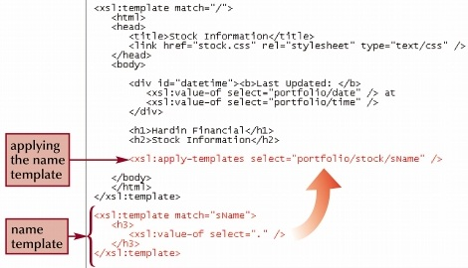
Using Template Example
Notes:
Show transform4.xsl and have them move text in file and apply the template in the xsl file

Slide 31
Using the Built-In Template
Each node has its own built-in template.
The built-in template for element nodes matches the document root and all elements in the node tree
The built-in template for text nodes matches all text nodes and causes their values to appear in the result document
For example, you can add the stock template to the style sheet

Slide 32
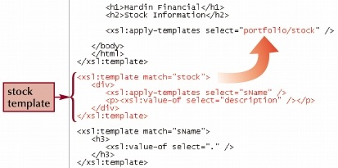
Creating a Template Example
Notes:
Use summary as the node for the template in transform4

Slide 33
Sorting Node Sets
By default, nodes are processed in document order, by their appearance in the document
To specify a different order, XSLT provides the <xsl:sort> element
This element can be used with either the <xsl:apply-templates> or the <xsl:for-each> element

Slide 34

Sorting Node Sets
The <xsl:sort> element contains several attributes to control how the XSLT process sorts the nodes in the source document
The select attribute determines the criteria under which the context node is sorted
The data-type attribute indicates the type of data
The order attribute indicates the direction of the sorting (ascending or descending)
Notes:
Add <xsl:sort order="ascending"/> to file. Show transform5.xsl

Slide 35
Conditional Nodes
XSLT supports two kinds of conditional elements:
<xsl:if>
<xsl:choose>
To apply a format only if a particular condition is met , use the <xsl:if> element
Use the <xsl:choose> element like a switch statement

Slide 36
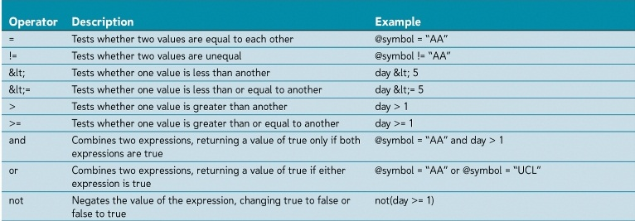
Comparison Operators & Functions
Notes:
Have choose with foreach added to file. Show transform6

Slide 37
Formatting
A number of formatting options on output
Use the format-variable where variable is one of the recognized variable types
Use as the value is selected
Format mask must also be in quotes so be careful with quotes
For example
<xsl:value-of select="format-number(@total_cost, '$###,###')" />
<xsl:value-of select="format-number(56823.847, '#,##0.00')“ />

Slide 38
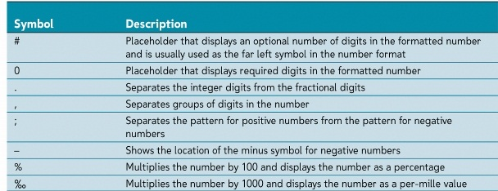
Number format symbols

Slide 39
<xs:decimal-format />
Holds decimal formatting information
Controls separator characters such as . and ,
Can be named or default if un-named
Named decimal format passed as argument to format-number

Slide 40
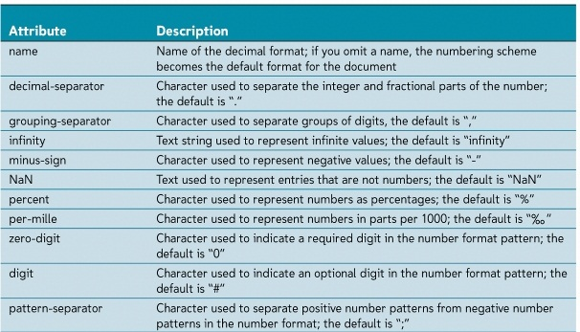
<xsl:decimal-format> Attributes

Slide 41
Calculations
Various ways to perform summation calculations
Can sum the values, find average, etc.
Simply call function with a node name when performing select
Example
<xsl:value-of select="sum(total_sold/@unit_cost)"/>
Notes:
Add formatting to books sold and total for region. File complete now. Show transform.xsl

Slide 42
Using Variables
Syntax: <xsl:variable name=“name” select=“value” />
Example: <xsl:variable name=”Months” select=”12” />
Names are case-sensitive
Value only set once upon declaration
Enclose text strings in single-quotes

Slide 43
Using Variables
Value can be XPath expression
<xsl:variable name="group" select="customers/customer [starts-with(@CID,’C’)]" />
Boolean type:
Set value to expression that is true or false
Result tree fragment type:
Syntax:
<xsl:variable name=”name”>
styles
</xsl:variable>
Notes:
Find out about tree fragment

Slide 44
Referencing Variables
Syntax: $variable-name
Example: $Months
Referencing tree fragments:
Do not use $variable-name
Use <xsl:copy> or <xsl:copy-of> to reference value
Example
<xsl:value-of select="count($group)" />

Slide 45
XPath Predicates
Expressions that test for a condition and create subsets of nodes that fulfill that condition
The predicate can also indicate the position of the node in the node tree
To select a specific position in the source document, use the position() function combined with any XPath expression
Examples:
node[1] selects first node from branch
node[last()] selects last
node[position() = 3] selects third node

Slide 46
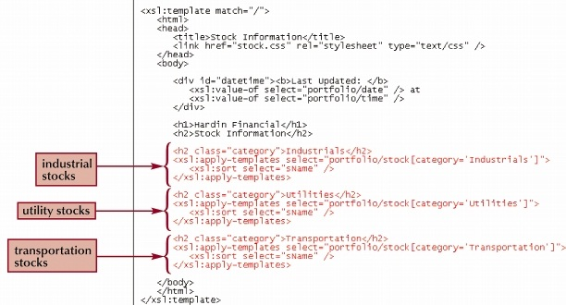
Predicates Example
Predicates indicate to choose each category of node portfolio/stock

Slide 47
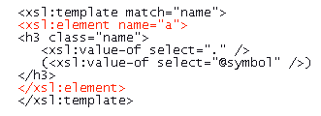
Creating Elements in XSLT
Use the <xsl:element> tag
The namespace attribute assigns a name to the element
The namespace attribute provides a namespace
The use-attribute provides a list of attribute-sets
Example:
Create the <a> element in the result document:

Slide 48
Creating an Attribute
Attributes are created in XSLT by using the <xsl:attribute> element
The name attribute specifies the name of the attribute
The namespace attribute indicates the namespace
You can create inline images in the result document by using the attribute tag

Slide 49
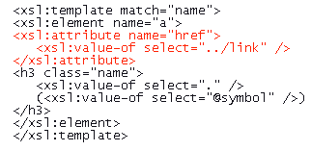
Creating an Attribute
To add the href attribute to the <a> tag, use the <xsl:attribute> element

Slide 50

Comments & Processing Instructions
The <xsl:comment> element creates the comment
Create a processing instruction by using the <xsl:processing-instruction> element
A processing instruction to attach the result document to the style.css sheet: (can also just add <link> element in html of style sheet)

Slide 51
Multiple Style Sheets
Use to create a library of XSLT code
<xsl:include>
Syntax: <xsl:include href=”URL” />
Same as inserting the components of included sheet directly into including file
Does not perform a direct text copy
Performs logical copy
If naming conflict occurs, last occurrence of template is used

